Slide 1
Probability
Approaches and Parameter Estimation

Slide 2
Frequentist vs Bayesian
Frequentists
Treat parameters as fixed but unknown
Rely solely on observed data to make inferences
Bayesian
Treat parameters as random variables with a defined prior
Updated beliefs with data to form a posterior distribution

Slide 3
Frequentist vs Bayesian
Frequentists
Training data is a random draw from the population
Uncertainty in estimates is quantified through the sampling distribution
Probability is long-run frequency
Bayesian
Uncertainty in estimates is quantified through the posterior distribution
Probability is degree of belief

Slide 4

Bayes’ Rule
Given two events A and B,
$$P\left(A, B\right)=P\left(A | B\right)ℙ\left(B\right)=P\left(B | A\right)P\left(A\right)$$
and,
$$P\left(A | B\right)=\frac{P\left(B | A\right)P\left(A\right)}{P\left(B\right)}$$

Slide 5
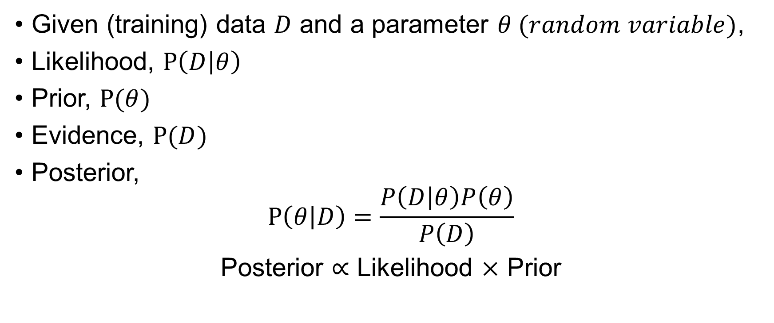
Bayesian Approach
Given (training) data $D$ and a parameter $θ (random variable)$,
Likelihood, $P\left(D | θ\right)$
Prior, $P(θ)$
Evidence, $P(D)$
Posterior,
$$P\left(θ | D\right)=\frac{P\left(D | θ\right)P\left(θ\right)}{P\left(D\right)}$$
Posterior $∝$ Likelihood $×$ Prior

Slide 6
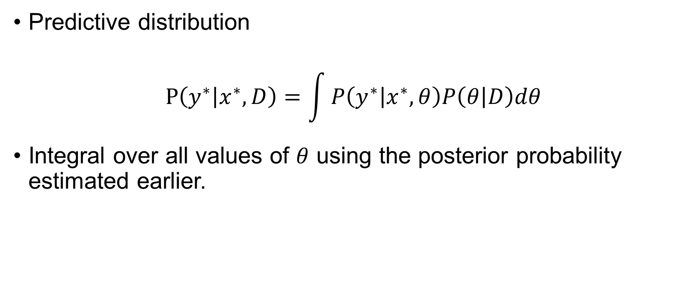
Bayesian Approach
Predictive distribution
$$P\left(y^{∗} | x^{∗}, D\right)=\int{P\left(y^{∗} | x^{∗}, θ\right)P\left(θ | D\right)dθ}$$
Integral over all values of $θ$ using the posterior probability estimated earlier.

Slide 7

Coin Flipping
Estimate the bias $θ$ of a coin, i.e., the probability of heads, where $θ∈\left[0, 1\right]$
N flips of a coin has yielded k heads.

Slide 8
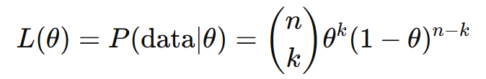
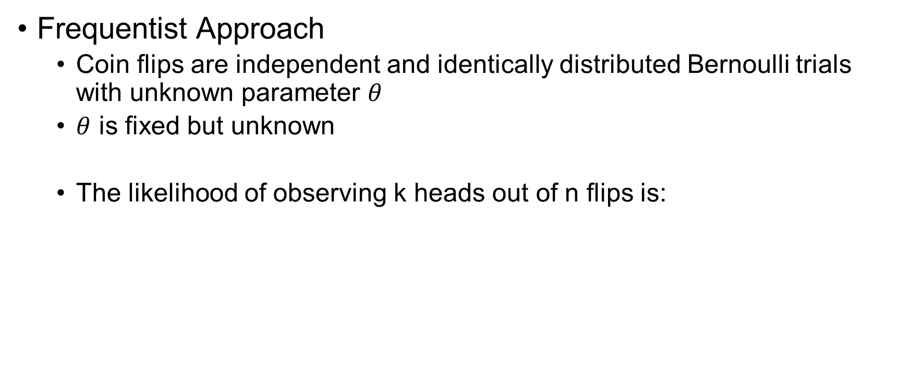
Coin Flipping
Frequentist Approach
Coin flips are independent and identically distributed Bernoulli trials with unknown parameter $θ$
$θ$ is fixed but unknown
The likelihood of observing k heads out of n flips is:

Slide 9


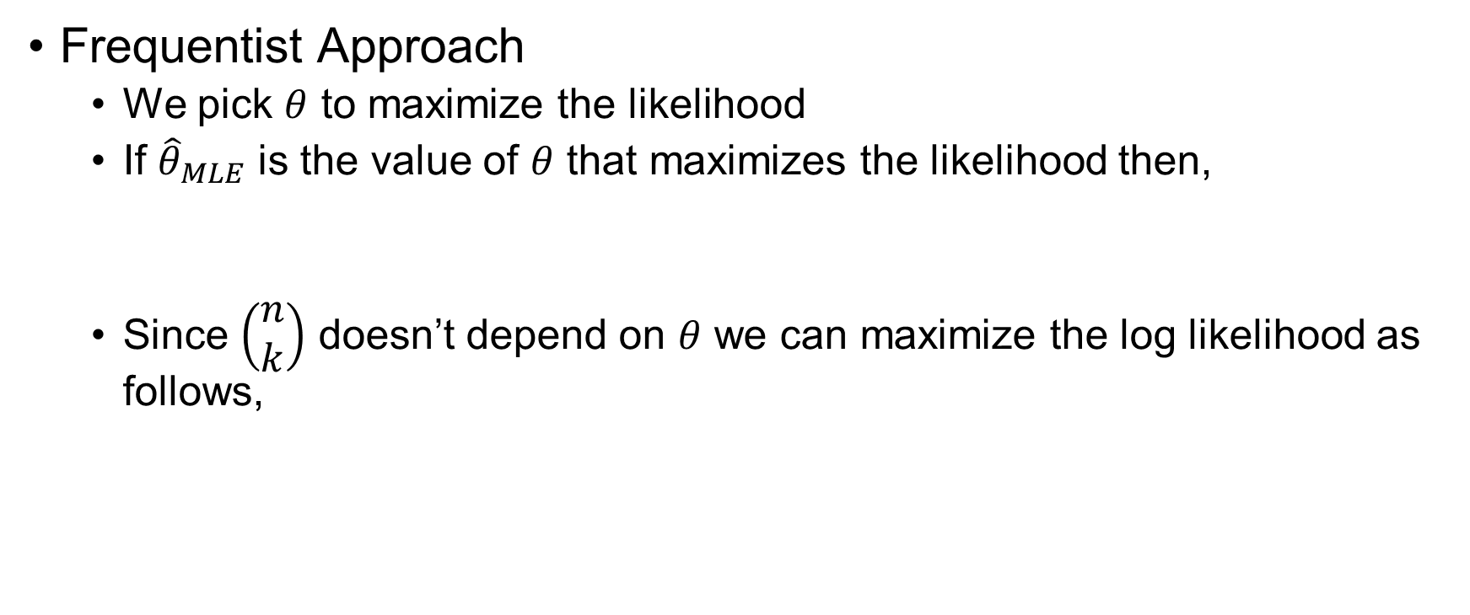
Coin Flipping
Frequentist Approach
We pick $θ$ to maximize the likelihood
If ${\hat{θ}}_{MLE}$ is the value of $θ$ that maximizes the likelihood then,
Since $\left(\begin{aligned}n \\ k\end{aligned}\right)$ doesn’t depend on $θ$ we can maximize the log likelihood as follows,

Slide 10
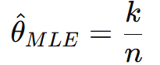
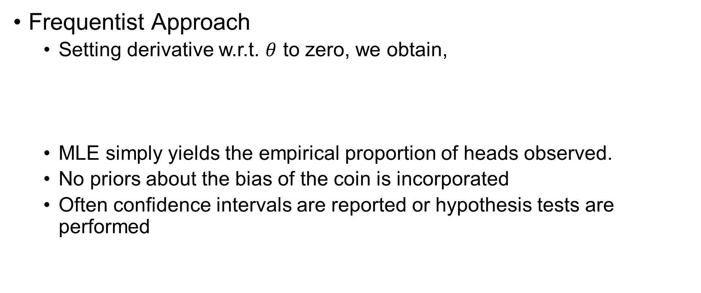
Coin Flipping
Frequentist Approach
Setting derivative w.r.t. $θ$ to zero, we obtain,
MLE simply yields the empirical proportion of heads observed.
No priors about the bias of the coin is incorporated
Often confidence intervals are reported or hypothesis tests are performed

Slide 11
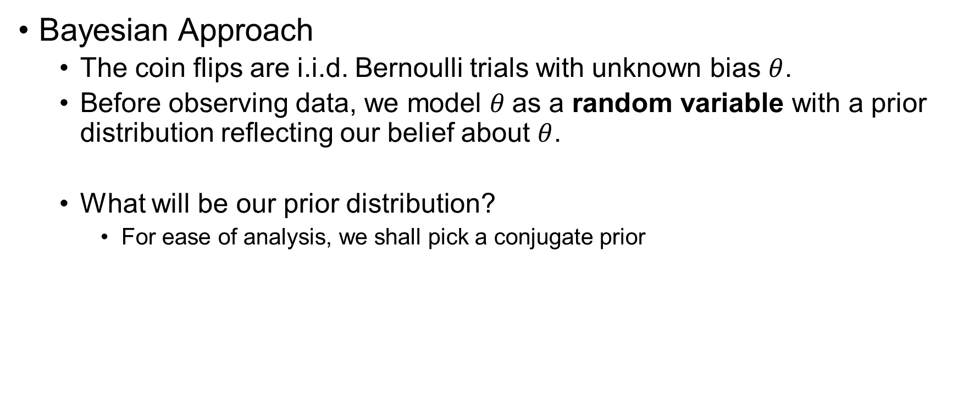
Coin Flipping
Bayesian Approach
The coin flips are i.i.d. Bernoulli trials with unknown bias $θ$.
Before observing data, we model $θ$as a random variable with a prior distribution reflecting our belief about $θ$.
What will be our prior distribution?
For ease of analysis, we shall pick a conjugate prior

Slide 12
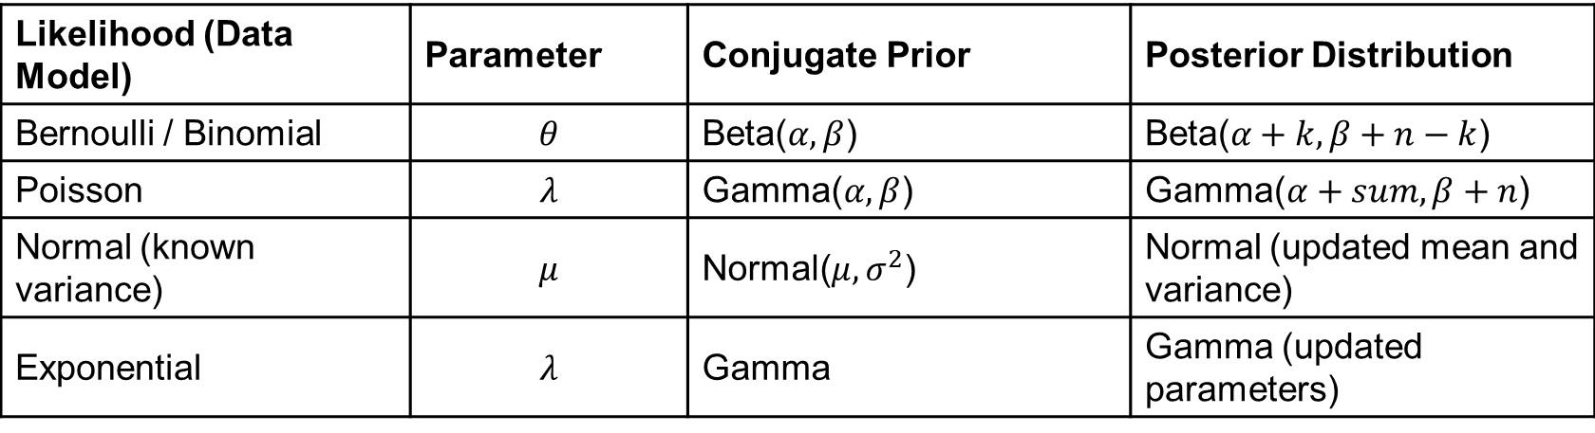
Conjugate Prior
A prior distribution
When combined with a specific likelihood function, yields a posterior distribution of the same family as the prior.
Likelihood (Data Model) | Parameter | Conjugate Prior | Posterior Distribution
Bernoulli / Binomial | $$θ$$ | Beta($α, β$) | Beta($α+k, β+n−k$)
Poisson | $$λ$$ | Gamma($α, β$) | Gamma($α+sum, β+n$)
Normal (known variance) | $$μ$$ | Normal($μ, σ^{2}$) | Normal (updated mean and variance)
Exponential | $$λ$$ | Gamma | Gamma (updated parameters)

Slide 13

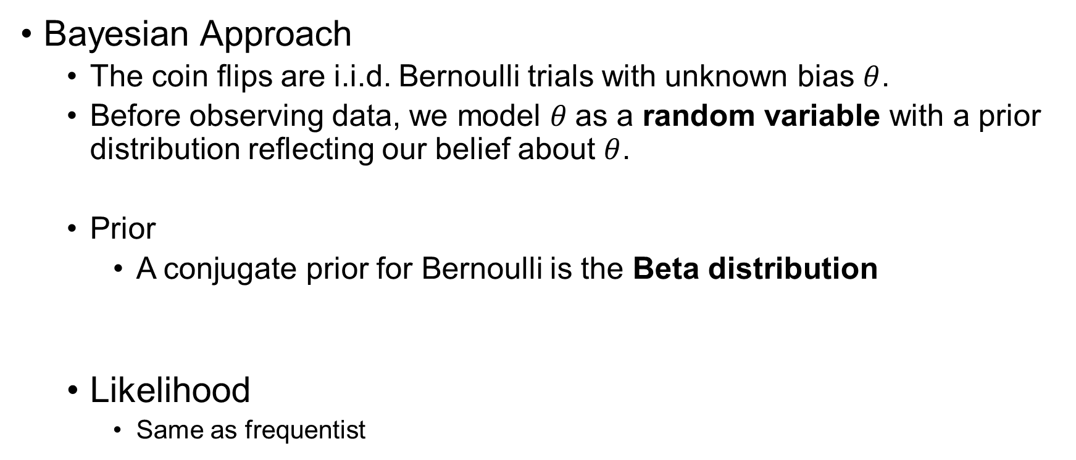
Coin Flipping
Bayesian Approach
The coin flips are i.i.d. Bernoulli trials with unknown bias $θ$.
Before observing data, we model $θ$as a random variable with a prior distribution reflecting our belief about $θ$.
Prior
A conjugate prior for Bernoulli is the Beta distribution
Likelihood
Same as frequentist

Slide 14


Coin Flipping
Bayesian Approach
According to Bayes’ theorem,
Since Beta prior distribution was used,

Slide 15
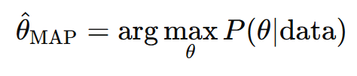
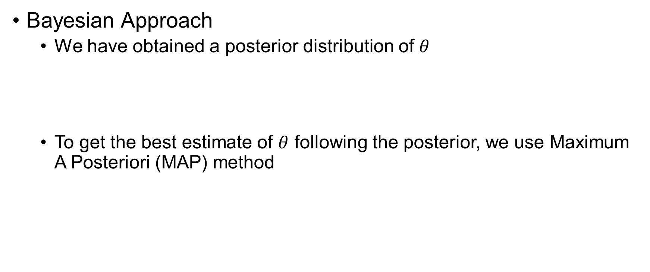
Coin Flipping
Bayesian Approach
We have obtained a posterior distribution of $θ$
To get the best estimate of $θ$ following the posterior, we use Maximum A Posteriori (MAP) method

Slide 16
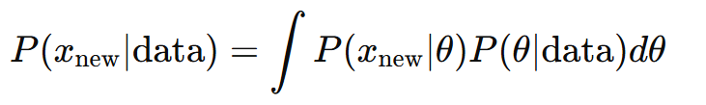

Coin Flipping
Bayesian Approach
Make predictions about the next coin flip $x_{new}$

Slide 17
Posterior Estimation
Posterior is intractable for most problems
How to do that?
Approximate Inference (Later!!)

